Slide 1

Lecture #6
“Corporate Growth Cycles I”
Lecturer: Prof Mischa Dohler
mischa.dohler@kcl.ac.uk
(07873 252 444)

Slide 2
$bn inspirations / ideas
Own necessities / problems we face every day
Trends in the market (sharing economic; circular economy; Gartner’s Hypecycle)
1 thing everybody needs / 1 thing everybody thinks they need
Gaps in the market / demand gap (how to identify?)
Better or more efficient version of something which has big market
www.kickstarter.com
Science Fiction movies:
Star Trek -> tablet / gps
Space odessey -> Skype
Avatar / transformers -> exoskeletons
Minority Report / Mission Impossible -> motion gesture, holograms
Inception -> what will we have in 2030? “Living in a dream”
Black Mirror -> prepare for the future
Interstellar -> new space travel methods
AI (with Jonny Depp) -> AI singularity
Black Panther & interactive video games

Slide 3
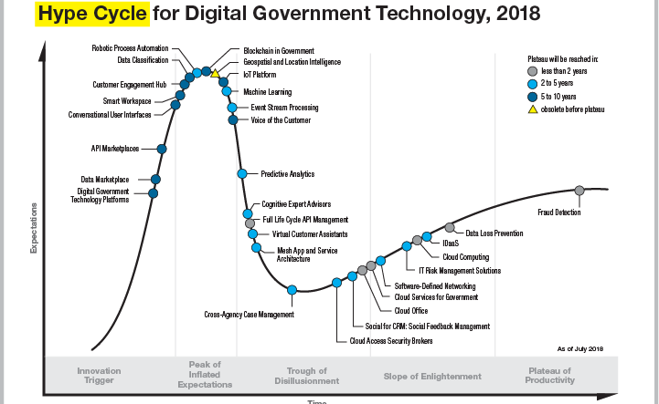
$bn inspirations / ideas

Slide 4
Class’s $bn ideas
Online lawyer (days of lawyers are counted!) and contract generator
Wireless ceiling- mounted phone charger
Wireless surveillance for government services (satellite data)
Lightshow with drones

Slide 5
Investment Equity %
Let’s assume you need $1m to get a prototype to market
What’s the profit in 5 years’ time? $1m
I value your company in 5 years’ time at 10x your revenue, i.e $10m
Projected value today is: NPV = $10m / (1 + %)^5; % = 50%; NPV = $1.32m
You ask for $1m: Investor gets $1m/$1.32m = 76%; you get 24%
Company is valued post-money: $1.32m
Company is valued pre-money: $320k
At seed investment: 25-40%

Slide 6
Investment Equity %
Let’s assume you need $1m to get a prototype to market
What’s the profit in 5 years’ time? $10m
I value your company in 5 years’ time at 10x your revenue, i.e $100m
Projected value today is: NPV = $100m / (1 + %)^5; % = 50%; NPV = $13.2m
You ask for $1m: Investor gets $1m/$13.2m = 7.6%; you get 92.4%

